Slide 1


PROJECT
7º Sprint Review
Turma B - Grupo 5
1170053 – Pedro Diniz
1211757 – Daniel Torres
1211759 – Diogo Veloso
1211765 – Gisela Araújo
1211779 – Márcio Carvalheiro
1211785 – Maurício Barros
1211788 – Patrick Rodrigues
1211797 – Tânia Mota
1211799 – Tiago Machado
1211801 – Valter Sousa

Slide 2
What we’ve been working on…
Sprint Goals
Implement Rest API Controller (Level 3)
Implement Spring Data JPA (H2)
Build front-end application using React.JS

Slide 3
What we’ll present…
Key points:
US 09: As a Product Owner I want to create Userstory and add it to the product backlog;
US 11: As an Authenticated User I want to change his/her password;
Sequence and class diagram;
Unit and Integration tests;
Front-end application;

Slide 4
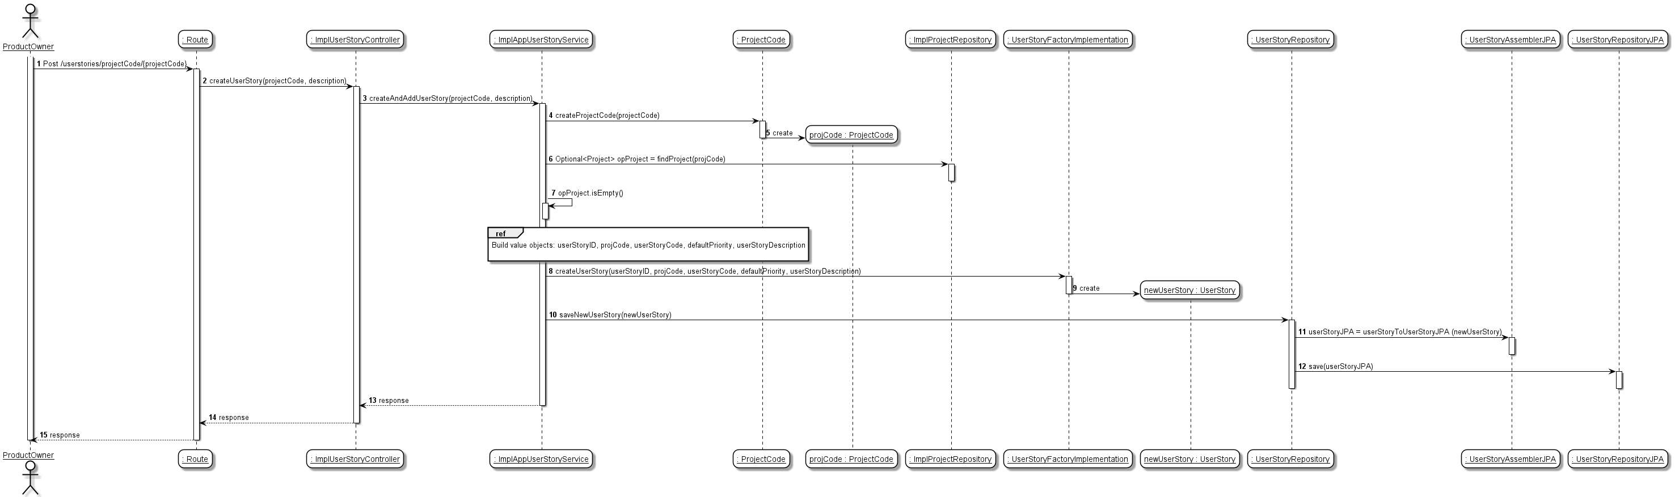
US009: Sequence Diagram
*** US009 - As a Product Owner I want to create Userstory and add it to the product backlog;

Slide 5
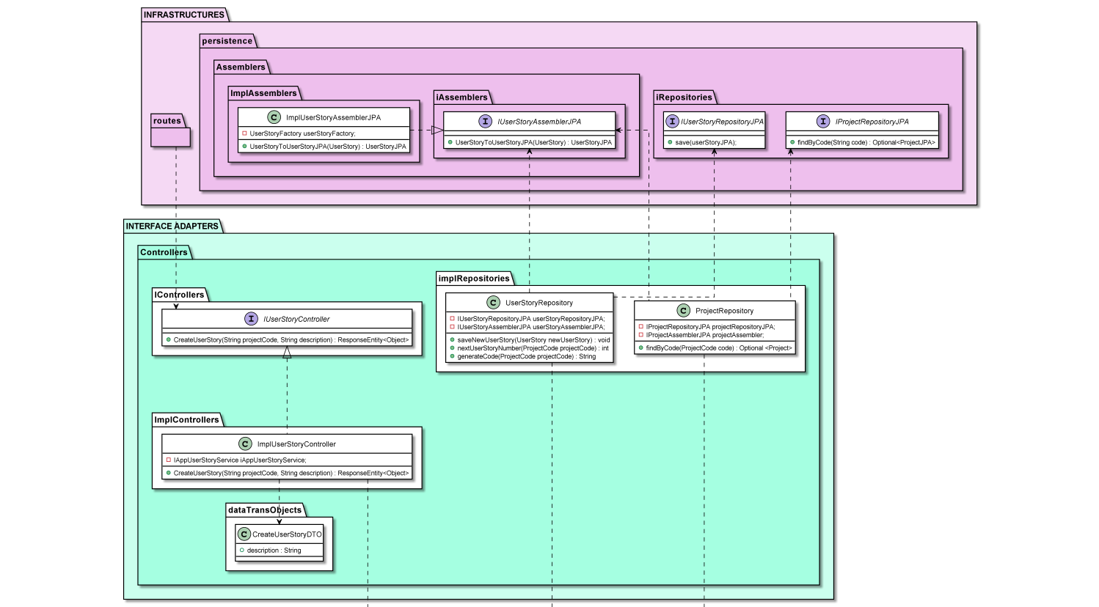
US009: Class Diagram
*** US009 - As a Product Owner I want to create Userstory and add it to the product backlog;

Slide 6
US009: Integration Tests
Create User Story successfully;
Fail to create User Story when project does not exist;
Fail to create User Story because description is invalid;
*** US009 - As a Product Owner I want to create Userstory and add it to the product backlog;

Slide 7
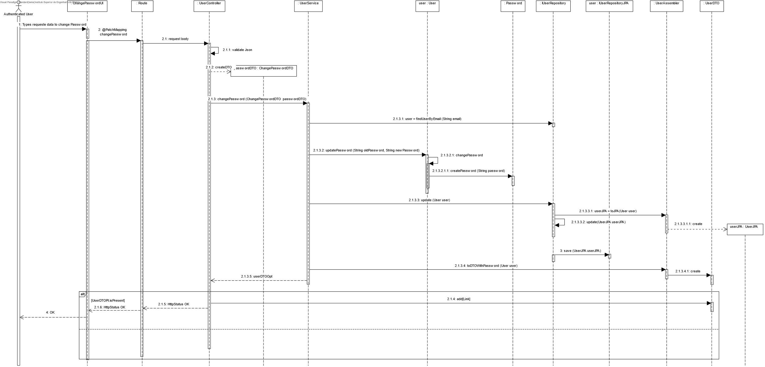
US011: Sequence Diagram

Slide 8
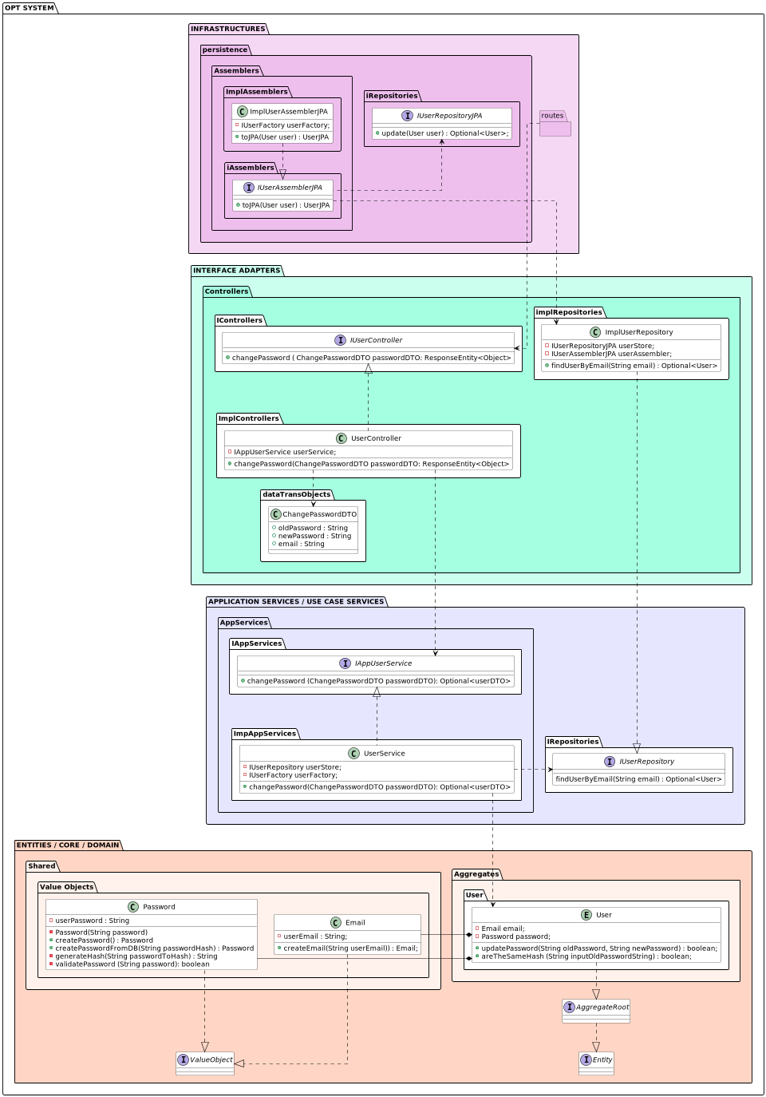
US011: Class Diagram
*** US011 - As an Authenticated User I want to change his/her password;

Slide 9
US011: Integration Tests
Create Password successfuly;
Create Password Failure because new password does not exist;
Create Password failure because new password is invalid;
*** US011 - As an Authenticated User I want to change his/her password;

Slide 10
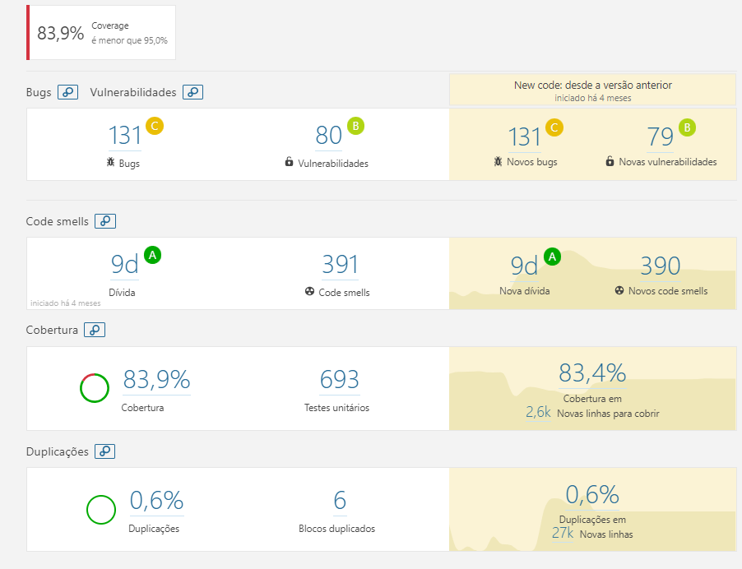
Quality Gate:

Slide 11
Let’s see some front-end….

